Slide 1
Small Business Engagement
For Stormwater Pollution Prevention
Erin Povak- Watershed Program Director
Liz Bolton - Outreach Specialist with Americorps

Slide 2
Non advocacy Science and policy org committed to restoring the greater Milwaukee Watersheds to conditions that are healthy for swimming and fishing
Stormwater pollution prevention focus
Educating residents in over 30 municipalities
Focus on behavior change
Notes:
Erin will define stormwater and discuss pollution in our area from this source

Slide 3
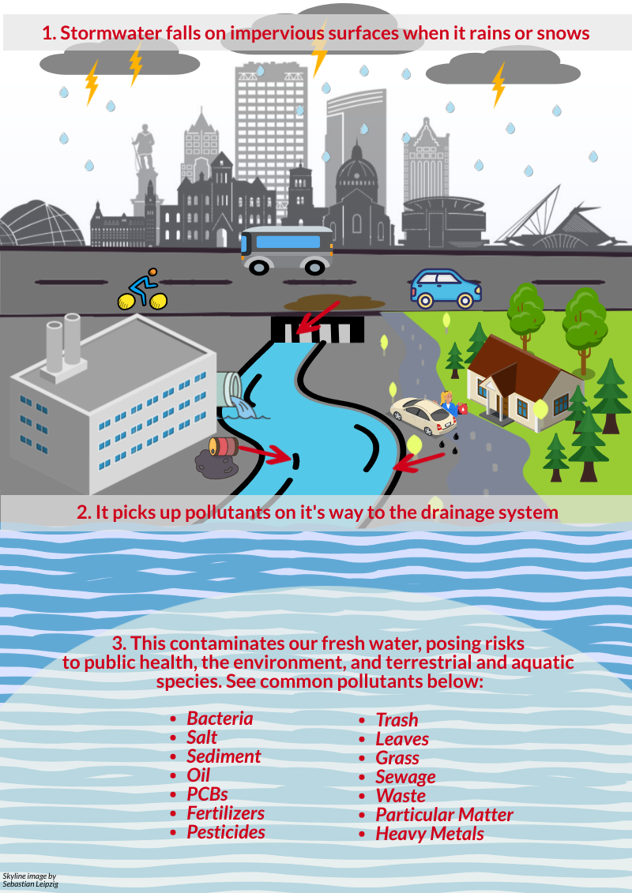

Slide 4
Why Small Business Engagement? What Was done?
The message for businesses is different than residents/A Lack of stormwater outreach to this group in our region
Phase 1 (2022-23)
Short conversations/surveys, assess knowledge and interest in future support
Test engagement strategies
Found a lack of training, understanding of connection
64% expressed desire for supporting materials
Some admitted to past spills
Phase 2 (2023-24)
Continuation of targeted engagement
Development of educational materials
Testing of materials via “mini” focus conversations
Create final portfolio of educational materials for various business types
Notes:
Add that is is mandated to reach this group via WDNR permit. Thai project sets us up to have more effective engagement materials.

Slide 5
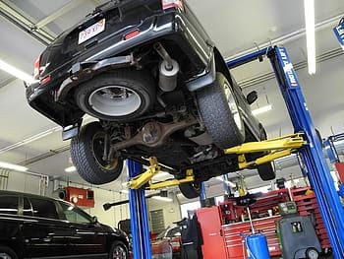
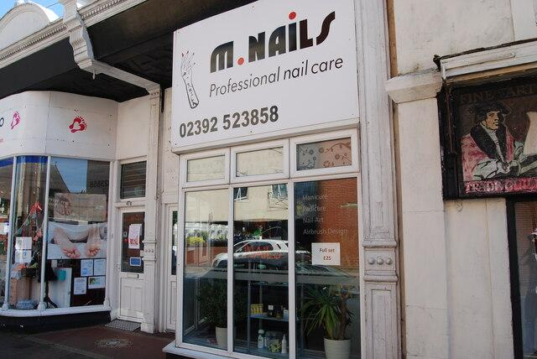
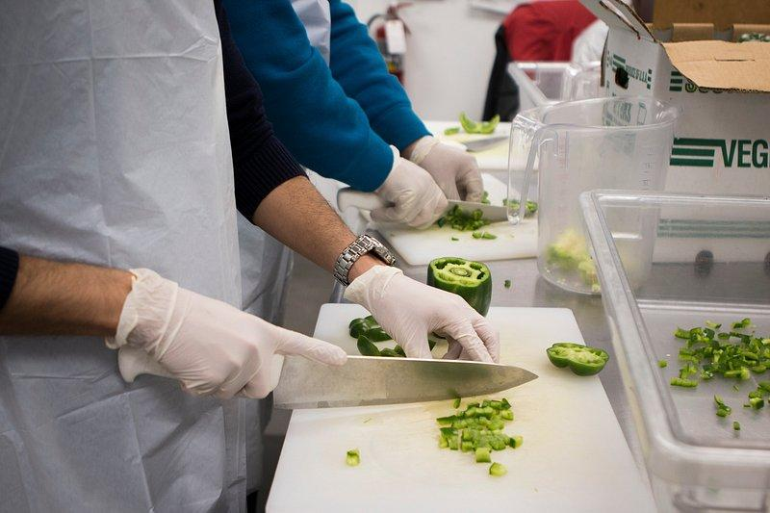
Specialized Materials Development: Categories
General:Catch-all for general pollution prevention strategies.
Food Service: Oil and bacteria are biggest concerns.
Automotive: May store materials outside, usually handles oils, metal shavings or dust.
Light Industry: May store materials outside, may have process dust or oils.

Slide 6
Background on Pollutants of Concern
Litter: Ensuring interiors and exteriors are free of litter.
Oils: Whether from a restaurant, automotive service, or light industry, we want to ensure proper containment or disposal of any oils.
Salt: Our priority is to get businesses to reduce their salt use, or have a discussion with their contractor about taking a training on salt management.
Chemicals: Could be any material/contaminant that finds its way to a storm drain.
Bacteria: Sources include leaking dumpsters, or rinsing waste containers near storm drains.

Slide 7
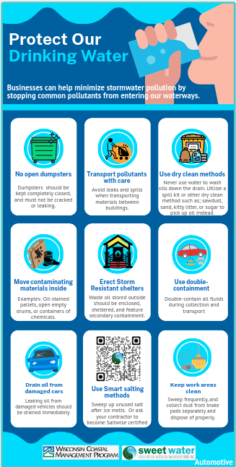
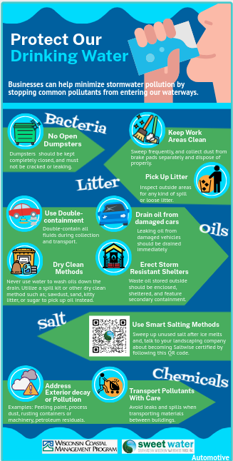
Automotive
Use double-containment: Double-contain all fluids during collection and transport.
Drain oil from damaged cars: Leaking oil from damaged vehicles should be drained immediately.
Erect storm resistant shelters: Waste oil stored outside should be enclosed, sheltered, and feature secondary containment.
Address exterior decay or pollution: Peeling paint, process dust, rusting containers or machinery, petroleum residuals.
Keep areas tidy: Sweep frequently and collect dust from brake pads separately and dispose of properly.
Transport pollutants with care: Avoid leaks and spills when transporting materials between buildings.

Slide 8
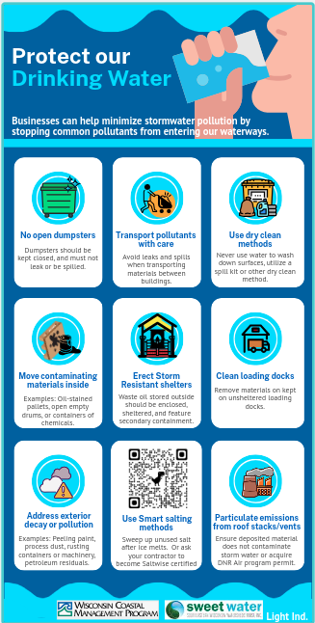
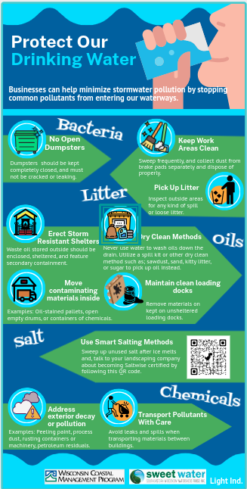
Light Industry
No Open Dumpsters: Dumpsters should be kept completely closed, and must not be cracked or leaking.
Erect Storm Resistant Shelters: Waste oil stored outside should be enclosed, sheltered, and feature secondary containment.
Use Smart Salting Methods: Sweep up unused salt after ice melts and, talk to your landscaping company about becoming Saltwise certified by following this QR code.
Address Exterior Decay or Pollution: Examples: Peeling paint, process dust, rusting containers or machinery, petroleum residuals.
Transport Pollutants With Care: Avoid leaks and spills when transporting materials between buildings.

Slide 9
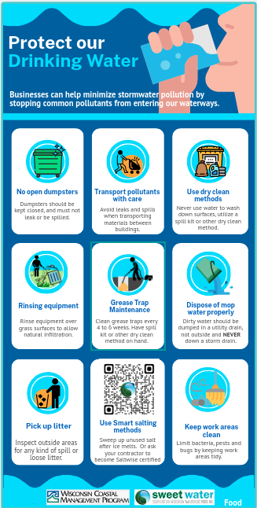
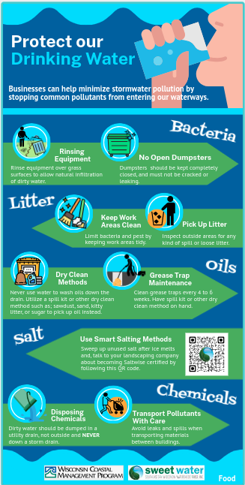
Food Industry
Grease Trap Maintenance: Clean grease traps every 4 to 6 weeks. Have spill kit or other dry clean method on hand.
Rinsing Equipment: Rinse equipment over grass surfaces to allow natural infiltration of dirty water.

Slide 10
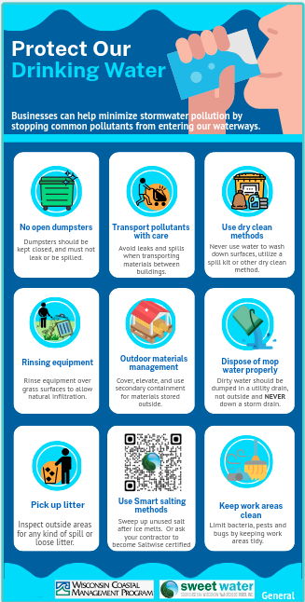
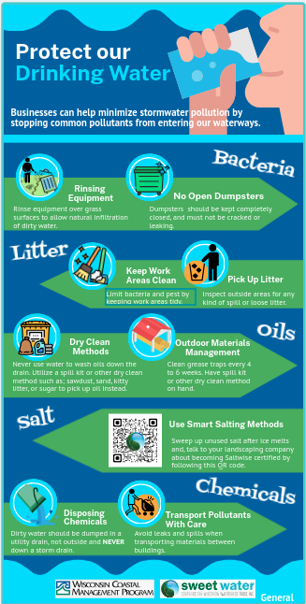
General
All strategies have been covered in previous examples. This could be used at a general storefront or a business with materials stored outside.

Slide 11
Feedback on materials?

Slide 12
Common small business Concerns
No Open Dumpsters: Dumpsters should be kept completely closed, and must not be cracked or leaking.
Keep work areas clean: Limit bacteria, pests and bugs by keeping work areas tidy.
Pick up litter: Inspect outside areas for any kind of spill or loose litter.
Dry Clean Methods: Never use water to wash oils down the drain. Utilize a spill kit or other dry clean method such as; sawdust, sand, kitty litter, or sugar to pick up oil instead.
Use Smart Salting Methods: Sweep up unused salt after ice melts and, talk to your landscaping company about becoming Saltwise certified by following this QR code.

Slide 13
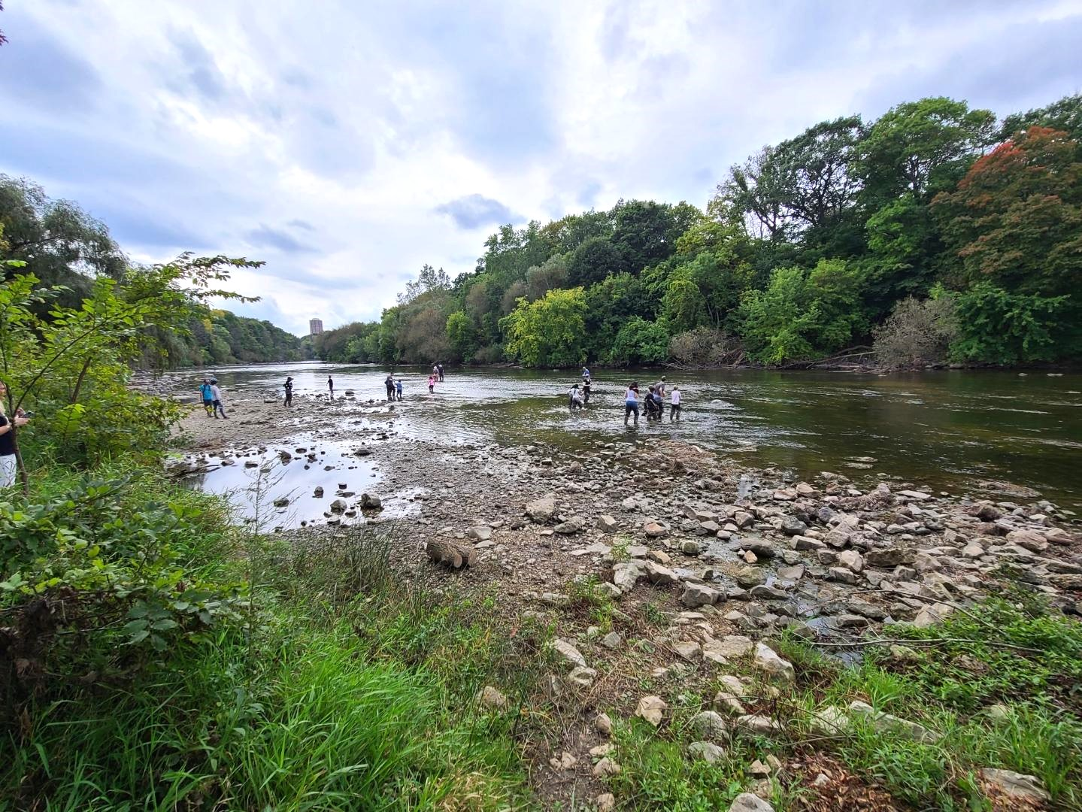
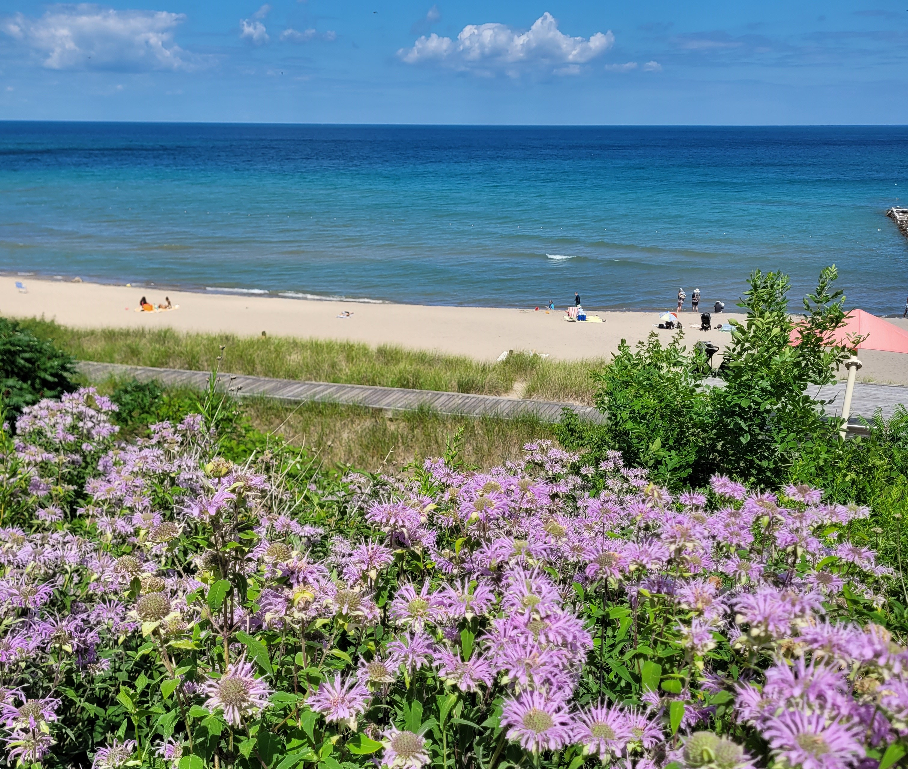
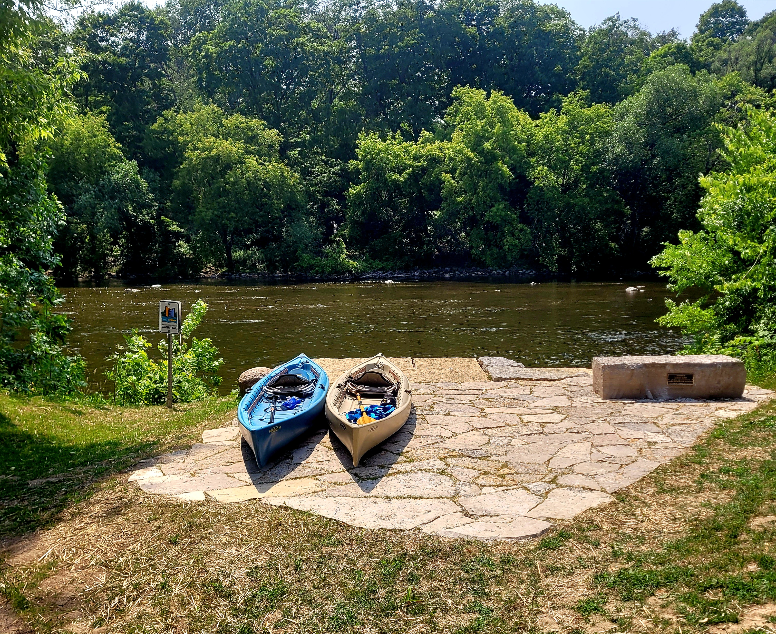
Connecting Shorewood residents to their local waterways and providing solutions to protect them.

Slide 14
A project of the Village of Shorewood DPW since 2011
Creating fun events, workshops and opportunities to get on the waters of the Milwaukee River
Creating a library of informational material to educate the public and students
Sharing weekly water and sustainability info with the Shorewood Conservation Committee in the Village weekly newsletter

Slide 15
Billboards, projects, bookmarks, magnets, lesson plans…

Slide 16
Events

Slide 17
Workshops

Slide 18
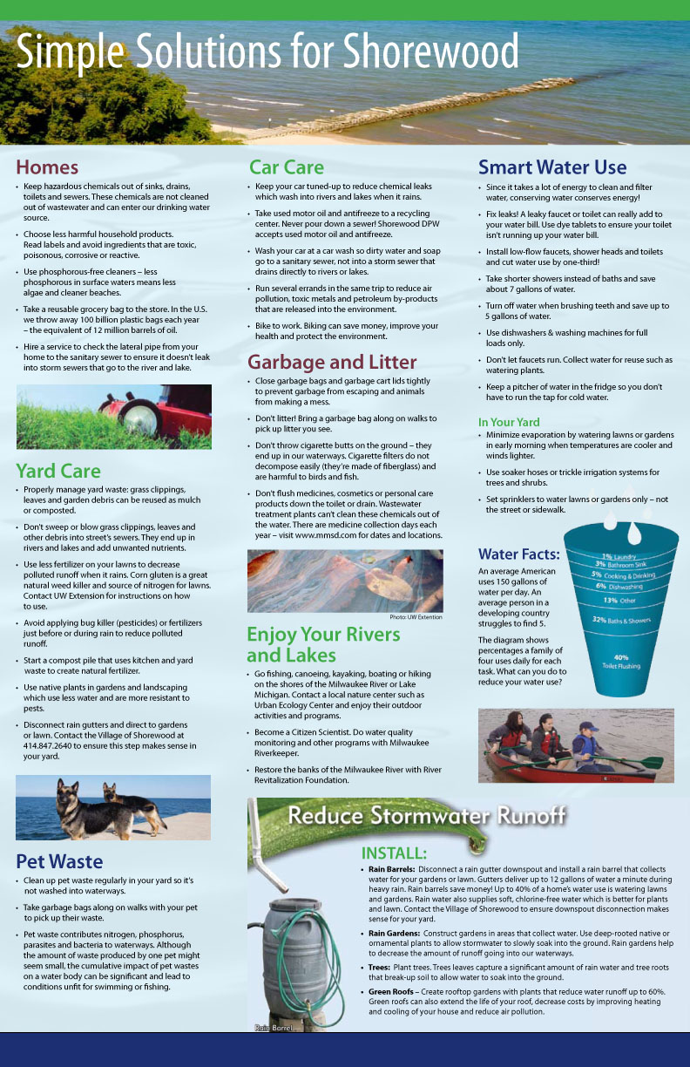
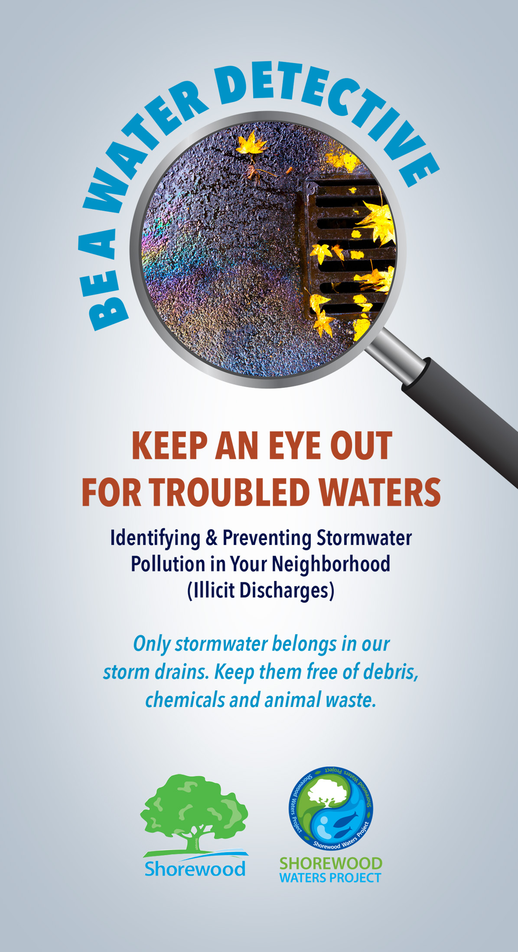
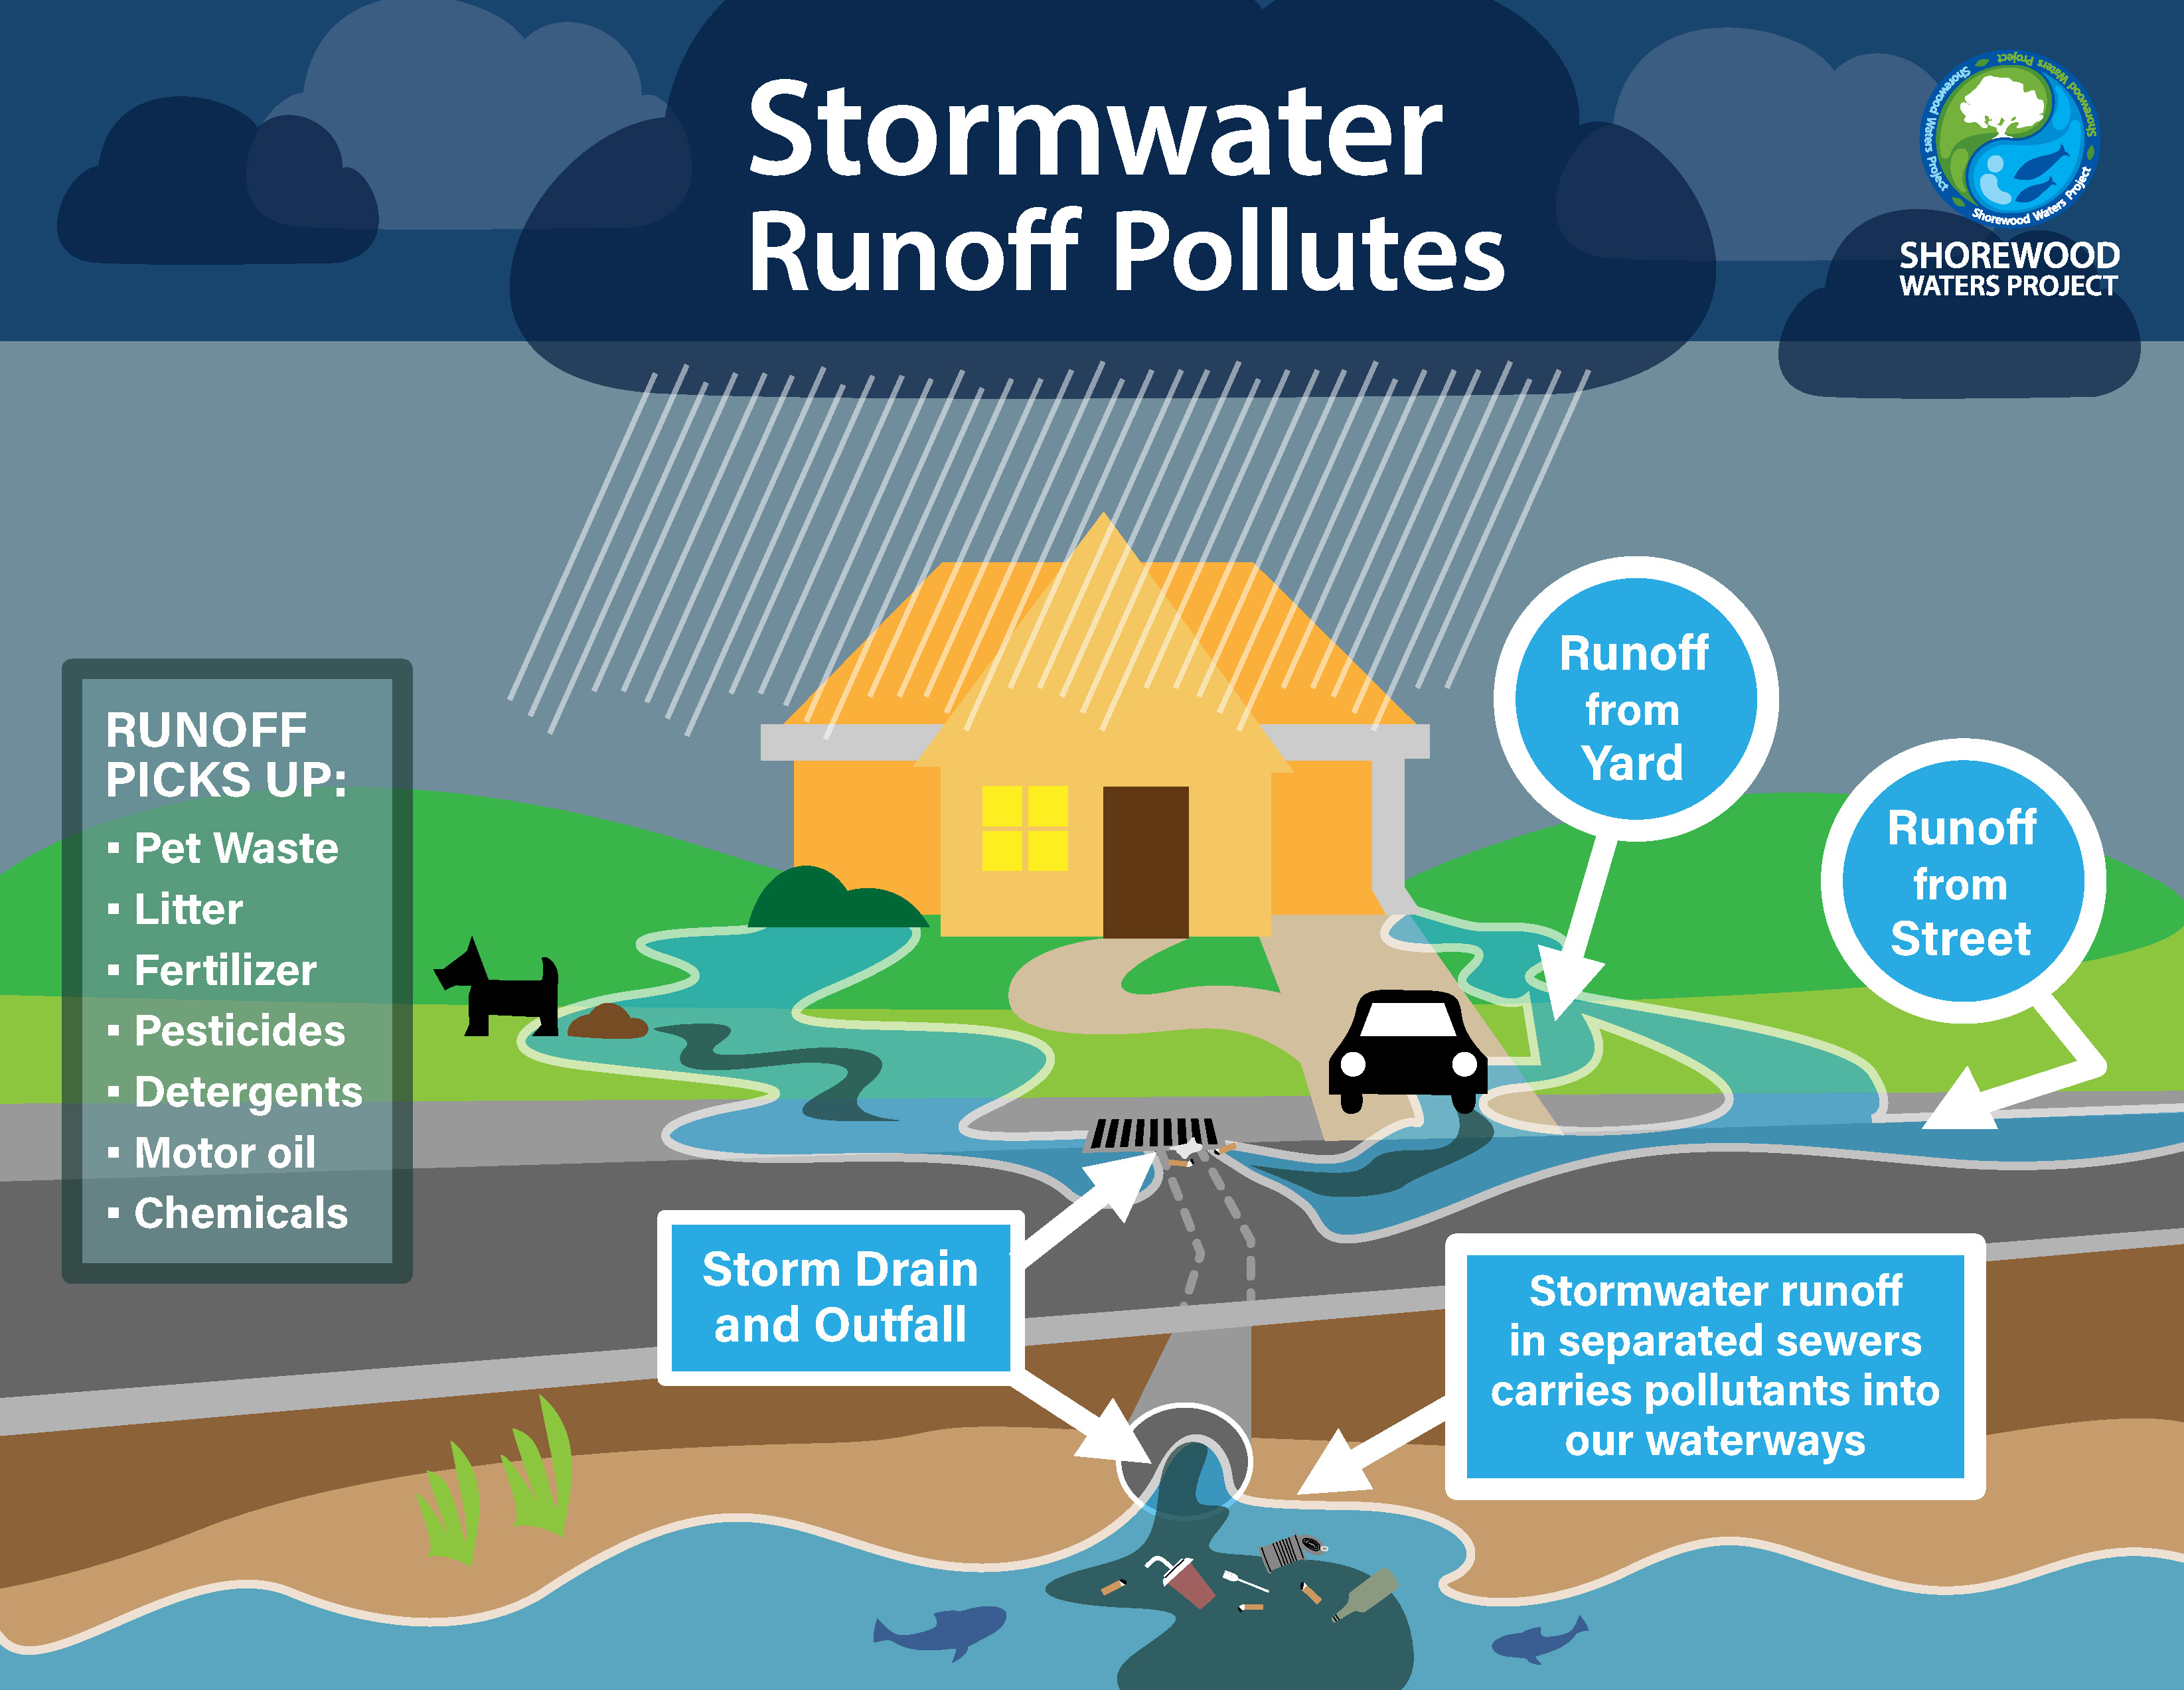
Educational Material

